Slide 1
Neural Rendering of Multichannel BRIRs for Personal Sound Zones with Head Tracking
Tanay Mannikar, Yue Qiao

Slide 2
Motivation
Compressed BRIR (binaural room impulse response) representation
Interpolation/extrapolation of unknown BRIRs
Real-time BRIR generation for PSZs with head tracking

Slide 3
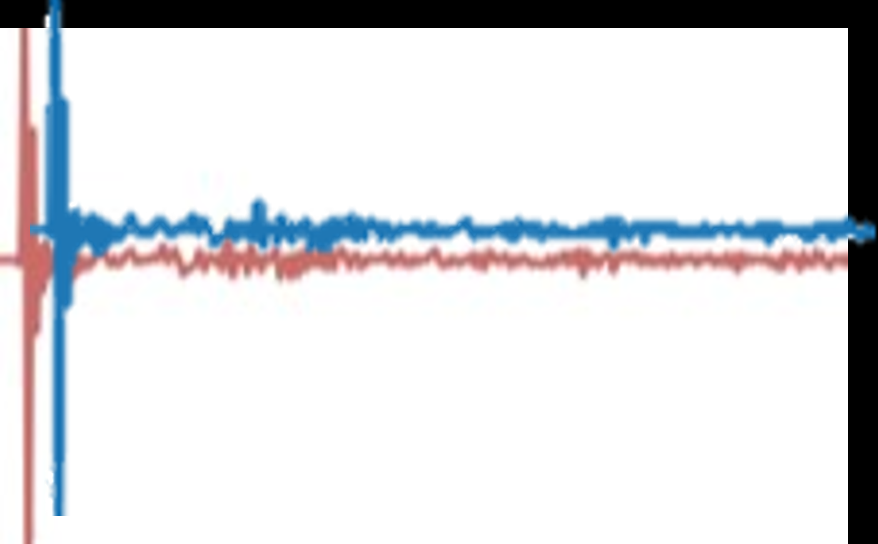

Analysis
Synthesis
(r, θ, φ)
(r, θ, φ)
Notes:
1. dataset analysis
brtf fluctuations, motivation for regression model
regression model – prove that scattering coefficients can perform in regression
Future step: test for sparsity
2. synthesis model
GAN/VAE with coefficients predefined layer during training

Slide 4
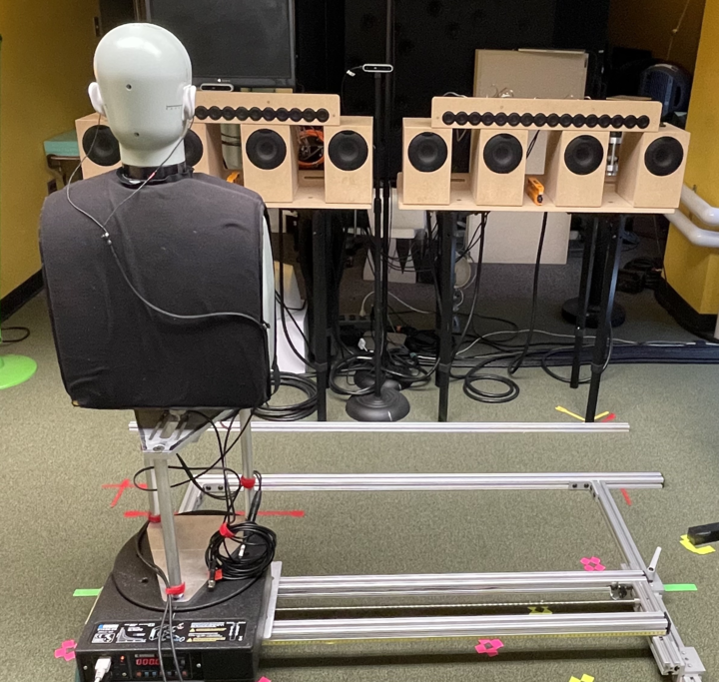
Understanding BRIR Dependencies
Single-speaker BRIR measurements from dummy head
0:1:360°, rotation
0:1:90 cm, horizontal translation (L→R)
Bandpass filtering (150 Hz – 7 kHz)

Slide 5
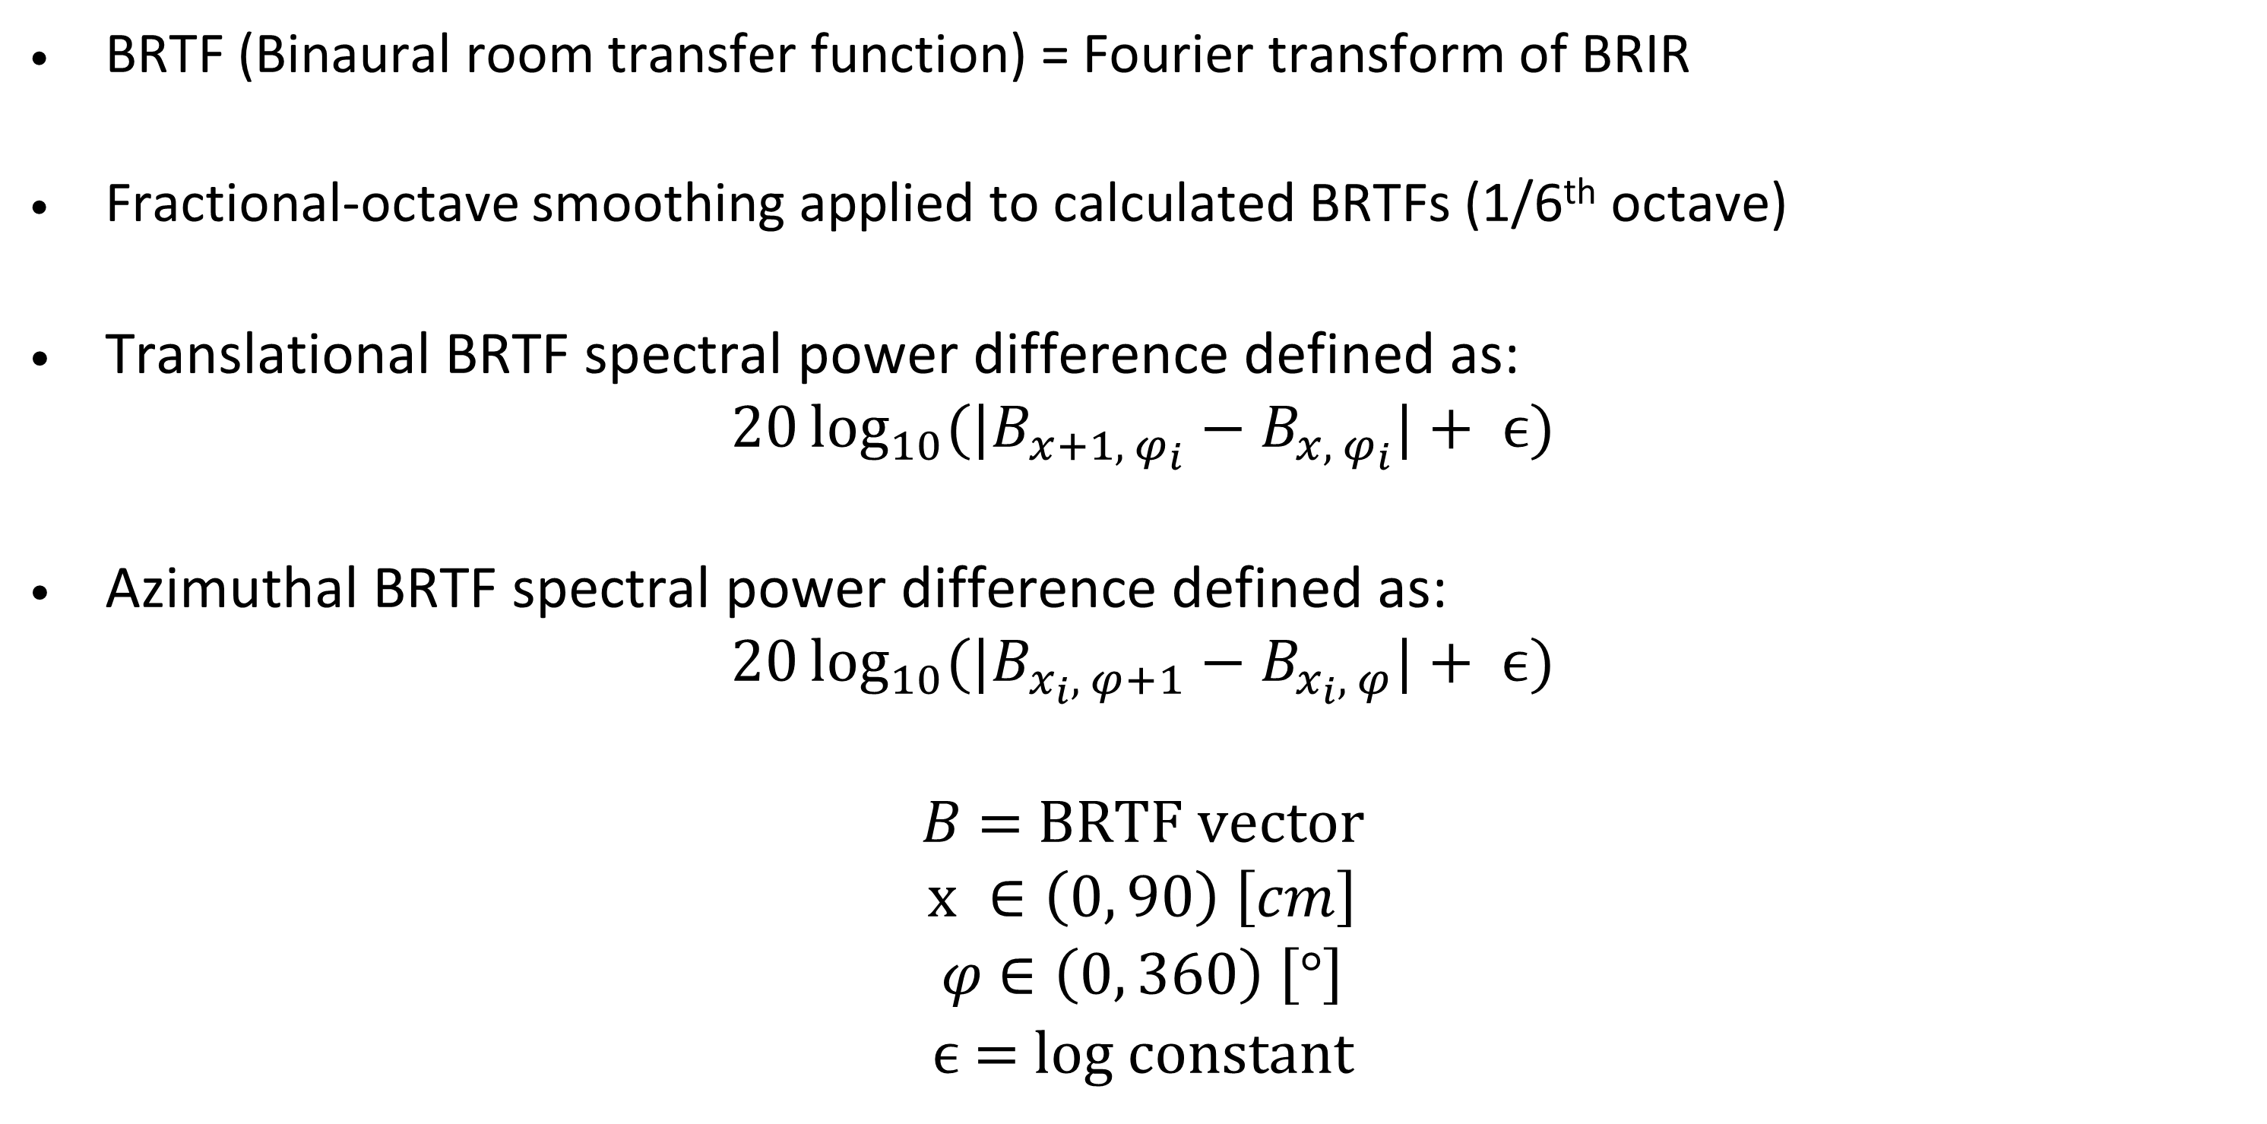
BRIR Spatial Dependencies
BRTF (Binaural room transfer function) = Fourier transform of BRIR
Fractional-octave smoothing applied to calculated BRTFs (1/6th octave)
Translational BRTF spectral power difference defined as:
$$20\log_{10}{({|B}_{x+1, φ_{i}}−B_{x,{ φ}_{i}}|}+ ϵ)$$
Azimuthal BRTF spectral power difference defined as:
$$20\log_{10}{({|B}_{x_{i}, φ+1}−B_{x_{i}, φ}|}+ ϵ)$$
$B$ = BRTF vector
$$x ∈\left(0, 90\right) \left[cm\right]$$
$φ$ $∈\left(0, 360\right) \left[\text{°}\right]$
$ϵ$ = log constant

Slide 6
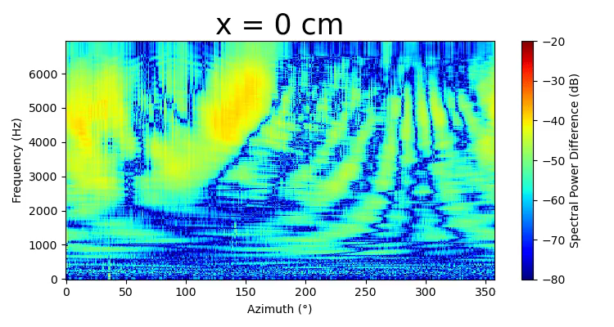
Spectral Power Difference vs. Azimuth
Smoothly shifting pattern over the translational range: easier to learn
Complex patterns: harder to learn
Head-related effects dominant

Slide 7
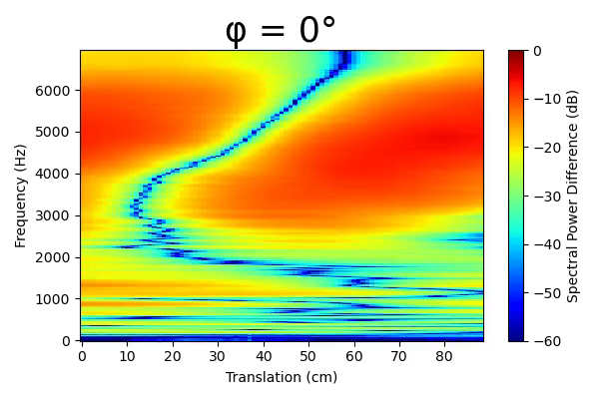
Spectral Power Difference vs. Translation
Few distinguishable patterns over the azimuthal range: easier to learn
Multivalued pattern evolution: harder to learn
Room effects dominant

Slide 8
Feature Extraction
Can BRIR frequency patterns be captured via feature extraction to match BRIRs to corresponding head orientations?

Slide 9
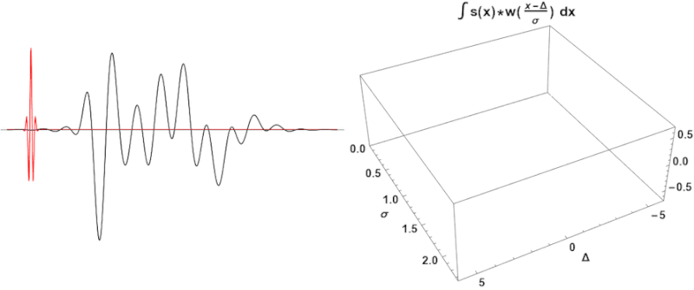
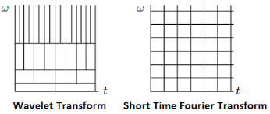
Continuous Wavelet Transform (CWT)
Multiresolution signal analysis, unlike Short-Time Fourier Transform (STFT)
Motivation: improved analysis of quick impulses with high frequency information [1]
[1] http://web.stanford.edu/class/ee269/LectureWaveletsPartII.pdf

Slide 10
Wavelet Scattering Transform
Extracts higher-order features from signals
Robust against deformations in time series and images [2]
Originally intended for dealing with sparse datasets
[2] J. Andén and S. Mallat, Deep scattering spectrum, IEEE Transactions on Signal Processing, vol.62, pp.4114-4128, 2014.
Notes:
Powerful tool for image texture classification, speaker/phrase identification with very sparse datasets, timbre classification, etc.
Overcomes loss of high-frequency information in other commonly-used feature extraction methods such as MFCCs

Slide 11
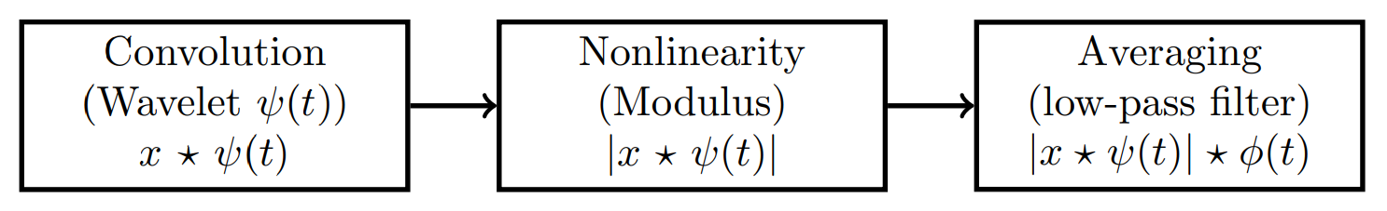
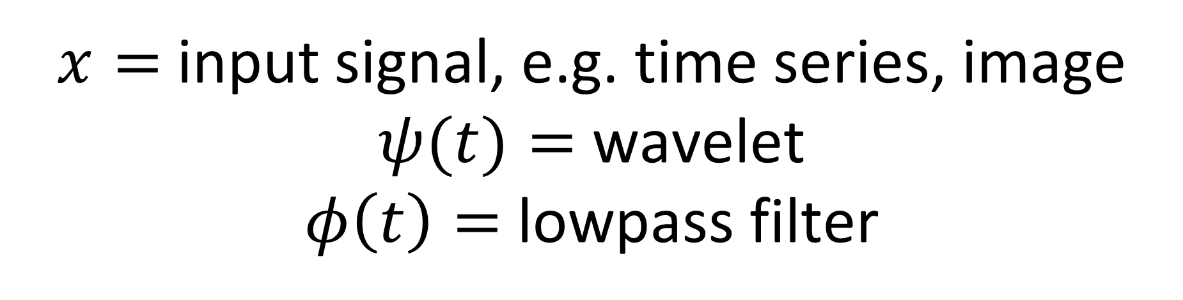
Wavelet Scattering Transform
$x=$input signal, e.g. time series, image
$ψ(t)=$wavelet
$φ\left(t\right)=$ lowpass filter
[3] W. Ghezaeil, L. Brun and O. Lézoray, "Wavelet Scattering Transform and CNN for Closed Set Speaker Identification," 2020 IEEE 22nd International Workshop on Multimedia Signal Processing (MMSP), Tampere, Finland, 2020, pp. 1-6, doi: 10.1109/MMSP48831.2020.9287061.
Notes:
Extracts higher-order analysis features from signals for classification tasks [1]
Robust against deformations in time/spatial domain
Overcomes Fourier transform instabilities
Originally intended for classification with sparse datasets
Powerful tool for image texture classification, speaker/phrase identification with very sparse datasets, timbre classification, etc.
Overcomes loss of high-frequency information in other commonly-used feature extraction methods such as MFCCs

Slide 12
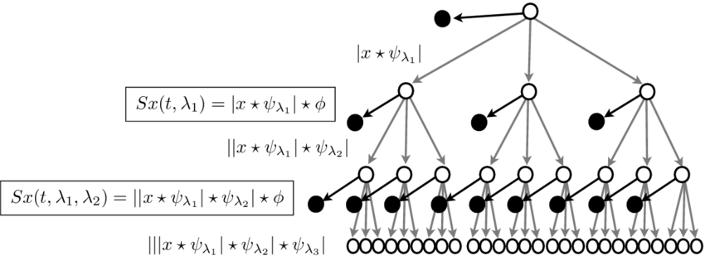
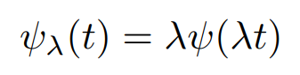
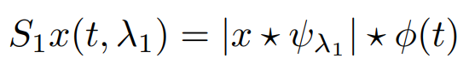

Wavelet Scattering Transform
Scattering scale $J$: ϕ(t) is of length $2^{J}$ samples
Notes:
Mother wavelet for each order: morlet
Quality factor Q = 8, defines filterbank resolution

Slide 13
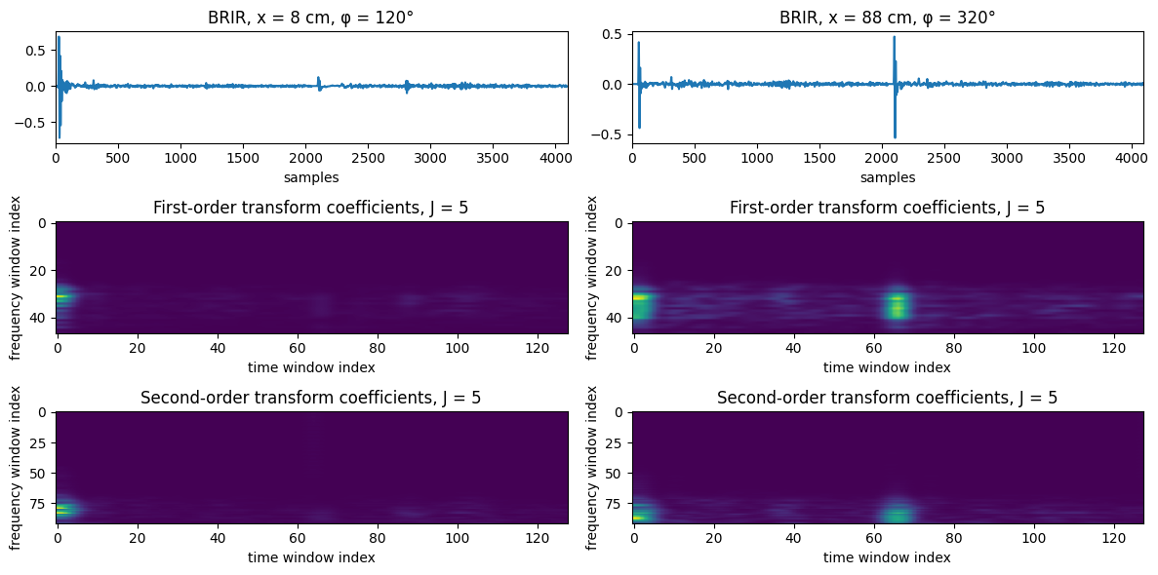
[4] Kymatio: Wavelet scattering in Python - v0.3.0 “Erdre,” Classification of spoken digit recordings. https://www.kymat.io/gallery_1d/plot_classif_torch.html
Notes:
Provides time-frequency representation of signal by convolving wavelets of varying time dilation across the signal to show similarity at each frequency bin – essentially a multiresolution filter bank
Differs from STFT in choice of time-frequency tiling for 1D signals : higher frequencies receive better time localization and over a wider range of frequencies, lower frequencies receive better frequency resolution over a wider range of time

Slide 14
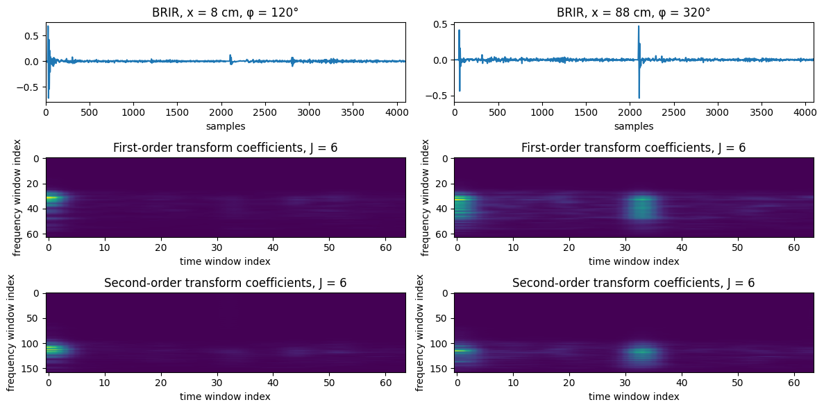
Notes:
Provides time-frequency representation of signal by convolving wavelets of varying time dilation across the signal to show similarity at each frequency bin – essentially a multiresolution filter bank
Differs from STFT in choice of time-frequency tiling for 1D signals : higher frequencies receive better time localization and over a wider range of frequencies, lower frequencies receive better frequency resolution over a wider range of time

Slide 15
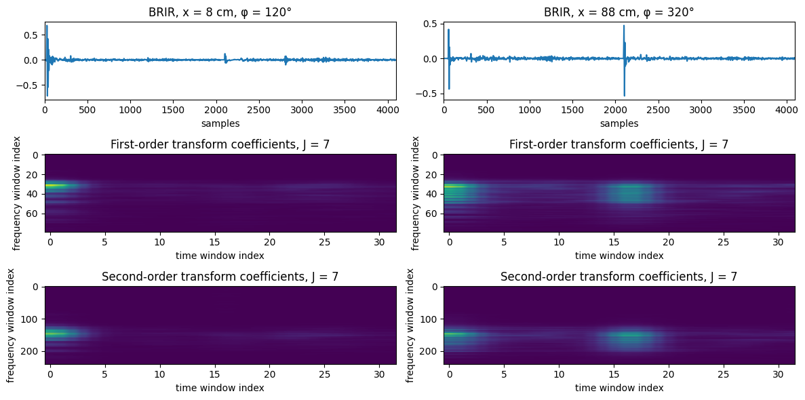
Notes:
Provides time-frequency representation of signal by convolving wavelets of varying time dilation across the signal to show similarity at each frequency bin – essentially a multiresolution filter bank
Differs from STFT in choice of time-frequency tiling for 1D signals : higher frequencies receive better time localization and over a wider range of frequencies, lower frequencies receive better frequency resolution over a wider range of time

Slide 16
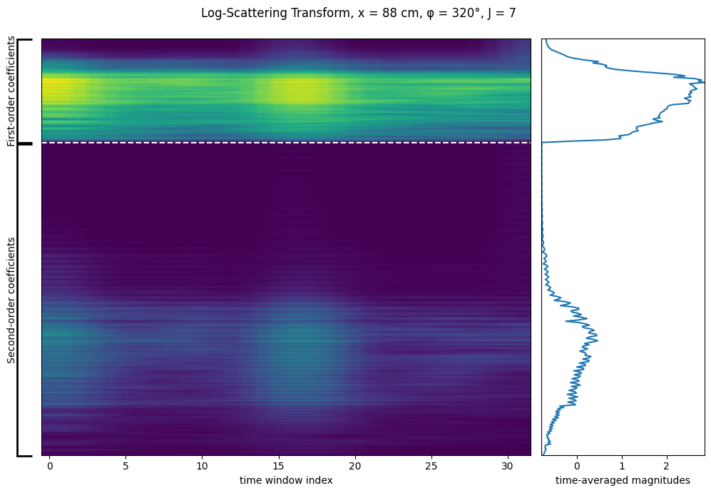
Apply log() to all scattering coefficients
Average (flatten) coefficients along time window index
Time-invariant representation!

Slide 17
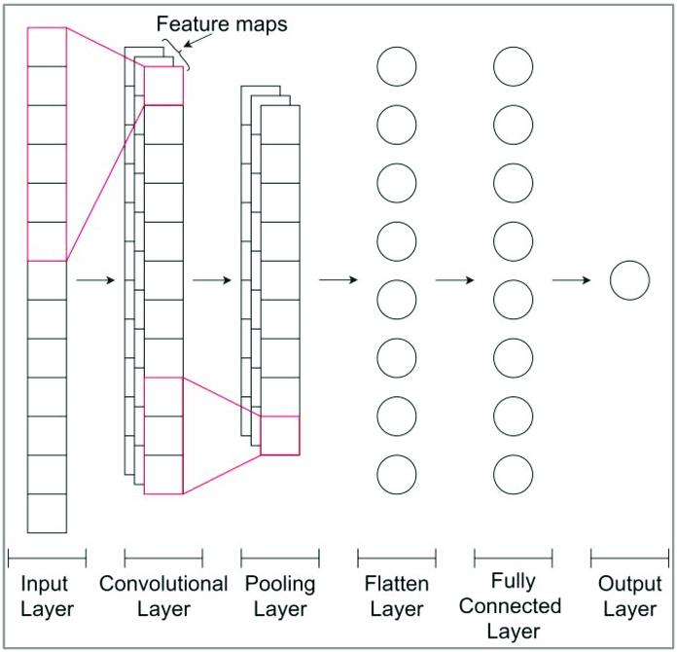
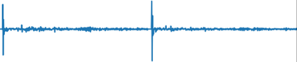
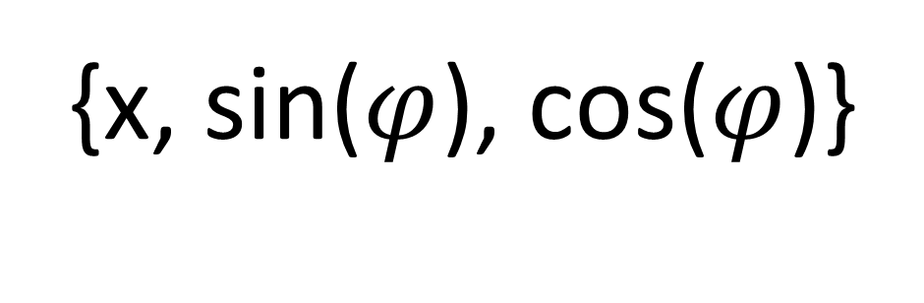
Model Comparison
1D Convolutional Neural Network (1D-CNN)
Baseline model: BRIR-CNN
Learns over raw time-domain information
Three candidate models: SCAT-CNN (J = 5, 6, 7)
Learns over time-averaged log scattering coefficients [5]
Input: concatenated L/R ear BRIRs
Output: Head coordinates
{x, sin($φ$), cos($φ$)}
[5] Massicotte, Philippe Yvan. Machine Learning with Feature Extractions for Regression Estimation of Binaural Sound Source Localization. doi: 10.22215/etd/2022-15283.
Notes:
Prior attempts have combined deep wavelet scattering networks with convolutional neural networks (CNNs) to perform binaural HRTF classification/regression [2] and robust speaker identification systems [3] on limited datasets with significant prediction accuracy
From [2], concludes that regression CNN allows for possible finer resolution predictions in HRTF azimuth and elevation/position predictions compared to standard classification approach
Model architecture for both CNNs builds off model in both [2] and [3] due to similarity of task

Slide 18
Model Tradeoffs
SCAT-CNN
More compact/compressed = RAM-friendly
For smaller J values,
compression increases
BRIR-CNN
Higher model complexity = RAM-intensive
No compression (baseline);
learns over full time-domain signal
Notes:
Prior attempts have combined deep wavelet scattering networks with convolutional neural networks (CNNs) to perform binaural HRTF classification/regression [2] and robust speaker identification systems [3] on limited datasets with significant prediction accuracy
From [2], concludes that regression CNN allows for possible finer resolution predictions in HRTF azimuth and elevation/position predictions compared to standard classification approach
Model architecture for both CNNs builds off model in both [2] and [3] due to similarity of task

Slide 19
Training and Evaluation
Total dataset size: 32760 BRIRs (360 x 91)
Validation/training data split: 25/75 %
Loss metric: Mean Squared Error (MSE)
Evaluation error metric: absolute scaled difference between true and predicted translation/azimuth

Slide 20
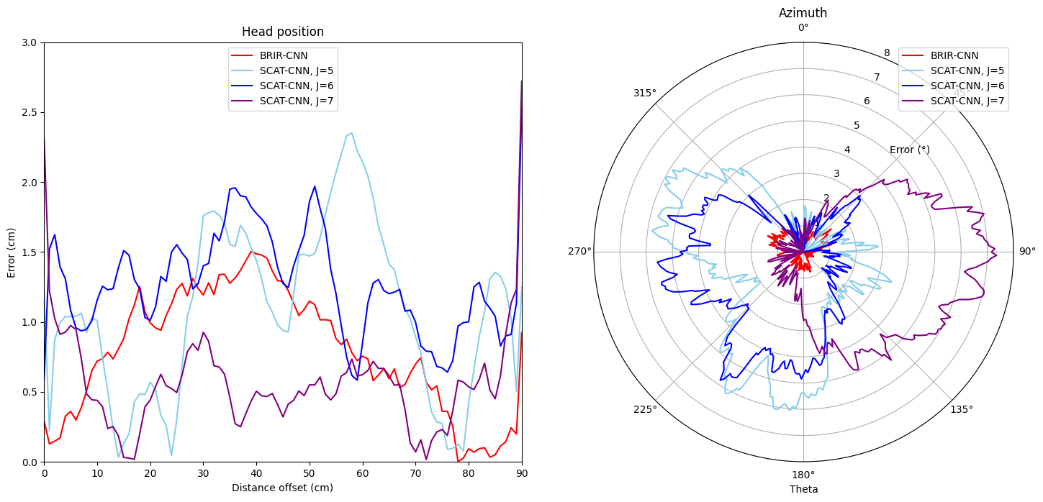
Notes:
SCAT-CNN and BRIR-CNN perform similarly at time invariance of J = 7 (i.e. more time-domain averaging and spreading)
SCAT-CNN of J = 5 and J = 6 do not have enough resolution to capture finer differences in frequency shifts between BRIRs; prediction accuracy diminishes

Slide 21
Takeaways
For x prediction, SCAT-CNN, J = 7 performs best
For φ prediction, J value is irrelevant

Slide 22
Future Analysis Steps
Train both models with sparser datasets
Bandpass BRIRs to further limited frequency range(s) to reduce input size
Verify robustness against varying initial propagation delay

Slide 23
Proposed Synthesis Work

Slide 24
Analysis
Synthesis
(r, θ, φ)
(r, θ, φ)
Notes:
1. dataset analysis
brtf fluctuations, motivation for regression model
regression model – prove that scattering coefficients can perform in regression
Future step: test for sparsity
2. synthesis model
GAN/VAE with coefficients predefined layer during training

Slide 25
Synthesis Approach
Transfer learning: pre-trained model weights
Fourier encoding ↔ phase information
γ(p) = {sin(2nπp), cos(2nπp)}, n = 0, 1, · · · , N
p = (r, Φ)
Time-averaged scattering coefficients ↔ frequency magnitude information

Slide 26
Synthesis Workflow
Wavelet
Scattering
Transform
(r, θ, φ)
Neural Network 1
(sparse dataset)
1
Coefficients
2
Frequency magnitude-dependent
learning
Neural Network 2
(r, θ, φ)
Phase-dependent learning
(full dataset)
3

Slide 27
Conclusions
Scattering coefficients
Allow compact BRIR representation
Efficiently represent room-related effects (x)
Poorly distinguish head-related effects (φ)

Slide 28
[1] http://web.stanford.edu/class/ee269/LectureWaveletsPartII.pdf
[2] J. Andén and S. Mallat, “Deep scattering spectrum,” IEEE Transactions on Signal Processing, vol.62, pp. 4114-4128, 2014.
[3] W. Ghezaeil, L. Brun and O. Lézoray, "Wavelet Scattering Transform and CNN for Closed Set Speaker Identification," 2020 IEEE 22nd International Workshop on Multimedia Signal Processing (MMSP), Tampere, Finland, 2020, pp. 1-6, doi: 10.1109/MMSP48831.2020.9287061.
[4] Kymatio: Wavelet scattering in Python - v0.3.0 “Erdre,” Classification of spoken digit recordings. https://www.kymat.io/gallery_1d/plot_classif_torch.html
[5] Massicotte, Philippe Yvan. “Machine Learning with Feature Extractions for Regression Estimation of Binaural Sound Source Localization,” doi: 10.22215/etd/2022-15283.

